Slide 1
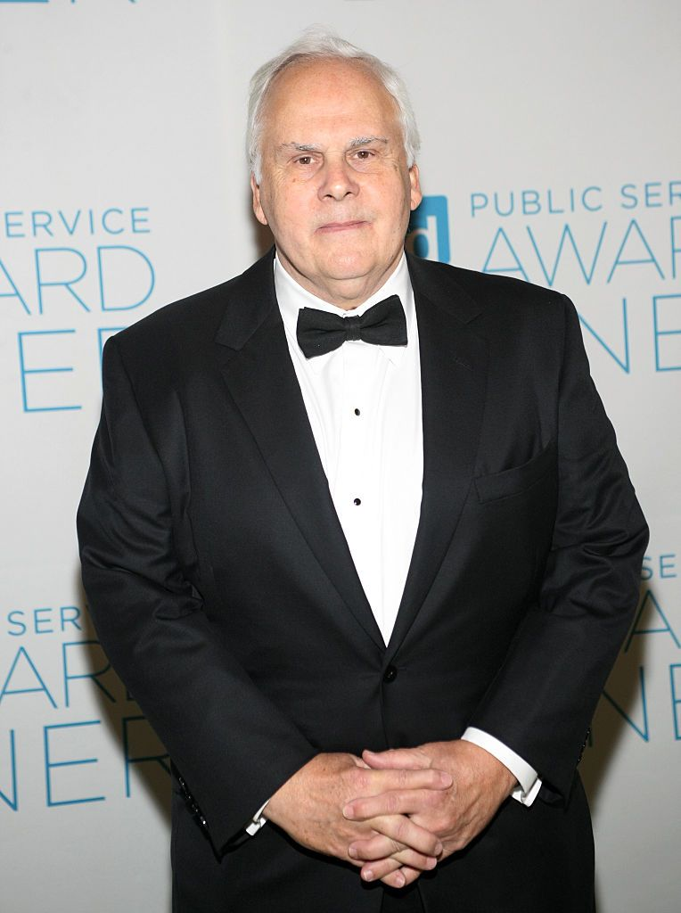
LEAD TEAMS
Fred Smith—CEO and founder of FedEx
Session 2
Leading a Team
S2-Jan 2019 v.2
Notes:
Instructor Guidance:
Purpose: To introduce and begin discussions of building the Team Leader.
Discussion:
After graduation, Smith was commissioned in the U.S. Marine Corps, serving for three years (from 1966 to 1969) as a platoon leader and a forward air controller (FAC), flying in the back seat of the OV-10. Much mythology exists about this part of his life; Smith was a Marine Corps "Ground Officer" for his entire service. He was specially trained to fly with pilots and observe and 'control' ground action. He never went through Navy flight training and was not a "Naval aviator" or "pilot" in the military. Individuals who completed Navy flight training and became a "Designated Naval Aviator" (pilot) were obligated to serve six years at the time. As a Marine, Smith had the opportunity to observe the military's logistics system first hand. He served two tours of duty in Vietnam, flying with pilots on over 200 combat missions. He was honorably discharged in 1969 with the rank of Captain, having received the Silver Star, the Bronze Star, and two Purple Hearts. While in the military, Smith carefully observed the procurement and delivery procedures, fine-tuning his dream for an overnight delivery service.^{[4]} He credits the Marine Corps with teaching him how to treat others and how to be a leader; two valuable lessons FedEx was built on.^{[10]\}
From Ciaran Foley’s 4 April 2016 article; “I quit: the Number 1 reason people leave their jobs! The strongest response highlighted the importance of the relationship with their manager. It is interesting that in the ever changing world we work in, the relationship people have with their direct manager still takes precedence over everything else. It has been said that people leave managers, not companies and it would appear that in this age of increased flexible working options and technological advancements (meaning less face time with your manager!), the strength of this relationship is still the key factor in retaining staff. This is reflected in the conversations that I have with HR professionals on a regular basis. Whether a relationship has soured or was never properly established, one of the most common must-haves in their next role is a manager they can trust, respect and work collaboratively with. Retrieved on 22 Oct 2017: https://www.linkedin.com/pulse/1-reason-people-leave-jobs-ciaran-foley/?trackingId=57EUFb0zNYo67CAEUYnBbw%3D%3D
Question: Ask students if there are any lingering questions from earlier sessions?
Next Slide: Session learning objectives.

Slide 2
Objectives
Comprehend and explain what is a Team Leader
Define and describe Team Leader qualities
Build and apply a plan to becoming an effective Team Leader
“I am not a product of my circumstances.
I am a product of my decisions.”
Stephen Covey
“Those who have a Why to live, can bear with almost any How”
Victor Frankel
Notes:
Instructor Guidance:
Purpose: Explain the three learning objectives for Session Three.
Discussion:
Address each objective but no need to go into detail at this point.
The point of the quote is to emphasize that we build ourselves to be what we think we are supposed to be.
As Victor Frankel explains, we decide how we will react and the decisions we make based on the circumstances we are in and the vision of where we see ourselves going.
Question: N/A
Next Slide: Funny video of a team leader holding a meeting for a staff/team meeting.

Slide 3
Team Leader
Notes:
Instructor Guidance:
Purpose: The purpose of the video is to inject a little humor and point to a goofy leader.
Discussion: We do learn through humor because it is a harmless way to look at ways not to lead others. Like the video from Lead Self, “Mike”, enthusiasm is contagious.
Question: N/A
Next Slide: Pair and Share!

Slide 4
Pair and Share Activity
With someone sitting
next to you, discuss “why
do you want to be a team
leader?”
Be prepared to share your reason with the seminar!
Notes:
Instructor Guidance:
Purpose: To have each student reflect on why they are taking the seminar and desiring to be a team leader.
Discussion: 1. Often we start on an activity or begin a new adventure without fully understanding why we are doing or thinking of the end-state of our actions. The pair and share offers a brief opportunity to such reflection. 2. Share with the seminar Pat’s story of her not wanting to be a leader. She was selected to be the General Manager for her talent and competence, not because she wanted the additional responsibilities of leading the Marine Shop.
Question: N/A
Next Slide: I think “That” about myths.

Slide 5
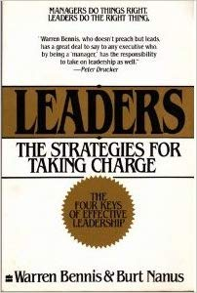
I Think That:
#1—Leadership is a rare skill?
#2—Leaders are born—not made?
#3—Leaders are Charismatic?
#4—Leadership exists only at the top of an organization?
#5—Leaders control, direct, prod, and manipulate?
#6—The Leaders sole role is to increase shareholder value?
(1997, 2nd ed. pp. 206-211)
Notes:
Instructor Guidance:
Purpose: To discuss some myths of what we think leaders are.
Discussion: Bennis and Manus (1997) discuss the misperception many people get concerning the difference between leaders and managers (pp. 206-211). They argue that education throughout the country, especially MBA programs stress the role of managers as quasi-leaders. Bennis and Manus write to dispel that notion and explain that leaders are different in role and responsibility (pp. 204-216).
Questions: The 6 questions are intended to get the students to state what they believe and then through discussion we dispel those myths based on Bennis and Manu’s claims.
Next Slide: What is a Team Leader?

Slide 6
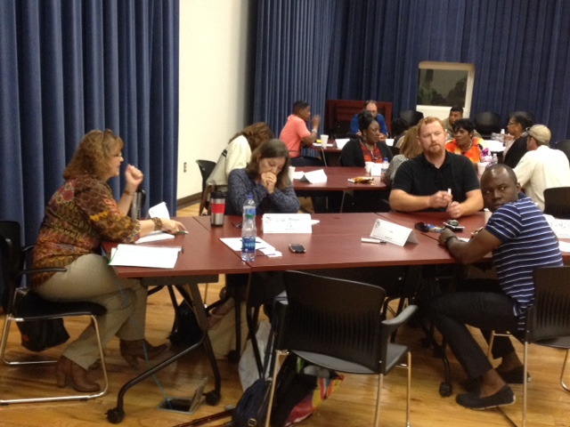
What is a Team Leader?
Someone who provides guidance, instruction, direction,
and leadership to a group for the
purpose of achieving a key result or
multiple aligned results.
A team leader:
Shares vision
Inspires
Develops team spirit
Engages and attentive to everyone
*Doing and Being (Authentic)
Lead Teams MCLB Albany
Jun 2017
Notes:
Instructor Guidance:
Purpose: To define and explain what is a team leader.
Discussion:
First share with the students your view of what is a team leader based on your knowledge and experience and what is written in the readings for this session. Then move to the bullets.
Scouller (2011) defined “the purpose of a leader is to make sure there is leadership…to ensure that all four dimensions of leadership are [being addressed].” The first four bullets above address each of those dimensions.
The fifth bullet, being authentic, means doing (your actions) what you believe in so people can trust you because you do what you say. We are being watched 24/7 which means that we have to actually do what we say in all things—Do what I say not what I do is a problematic behavior which causes others to not trust us. To avoid issues in this area, strive to be competent and confident in a genuine manner.
Steve Gladis, (AdjProf—GMU) advocates being engaged and doing leadership and importantly being the leader in a holistic manner.
Questions: Ask students what each of the bullets mean to them. Ensure to ask those students who are hesitant to engage in the conversations.
Next Slide: Why are leaders important?

Slide 7
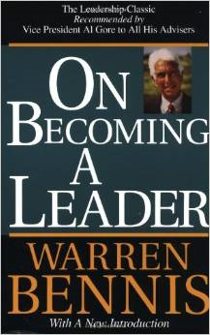
Why are leaders important?
Responsible for effectiveness of the [team]…
We need anchors [role models]
in our lives…
[Provide] integrity for the organization [team]
Build trust that adds value…
(1994, pp. 15-16)
Notes:
Instructor Guidance:
Purpose: To develop a short discussion on why leaders are important.
Discussion: 1. Bennis provides interesting reasons why leaders are important to us and society. Mostly because we live in a complex world and everyone has agendas to achieve their destiny (1994, pp-15-16). 2. Anchor points are guides we rely on to aim us to successfully leading others. It is like the Bracelet “WWJD”—what would Jesus do? Think of the most influential people in our lives and how their examples are anchor points in our lives. 3. Sinek also provides several provocative topics related to leading others. He states that trust is critical, specifically, trust is a feeling, not a rational experience (Sinek, 2009, p. 84). He goes on to state that with trust comes value because by definition, value is the transference of trust (p. 84).
Questions: Asks students to respond to the four reasons why we need leaders. Get their views on the how leaders affect us and our organizations. Keep them focused on team leaders and not wander to far into the political leaders.
Next Slide: Break!

Slide 8
10 Minute Break!
Notes:
Instructor Guidance:
Purpose: Announce break.
Discussion: State time to return and tell students next will focus on advantages of teams.
Question: N/A
Next Slide: Colin Powell and trust.

Slide 9
Colin Powell
Notes:
Instructor Guidance:
Purpose: To better understand the importance of trust.
Discussion:
Gen Colin Powell led the military and as Secretary, led Department of State with success. A key component of his success was his ability to develop trust with his people. A key characteristic of leading teams and larger organizations is getting others to trust you.
People trust us because we show and live integrity. It is the foundation of our character. Without it or with a reduced version of it we are not a leader because no one will follow us—no one to lead.
Questions:
Do you trust your supervisor and leaders within your chain of authority? Why?
If not, why not?
How do you develop or maintain a climate of trust?
Next Slide: Some qualities of a Team leader.

Slide 10
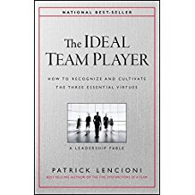
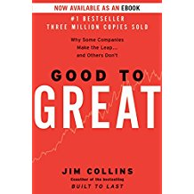
Some Qualities of a Team Leader
Humble
Hungry
[people] Smart
KER
Level 5 Leaders
Notes:
Instructor Guidance:
Purpose: To define and discuss qualities of a team leader.
Discussion:
(Lencioni) The ideal team (player) leader is a person who puts team first. By being humble, the team leader focuses on the needs and success of team members. By remaining inspired and motivated [Hungry] to provide superior products and services for the organization and customers the leader keeps the team on a positive performance track with a positive and contagious spirit. The team leader needs people smarts to engage the right people to make a difference and help in making the team its best. Having the 6th sense (KER)—knowledge, experience, and reflection)) to select and support the right people. Getting the team players who are doing the mission within the intent of the leader.
(Collins) In their study, they determine that successful companies that sustain success have leaders with Level-5 leadership—ability to turn ego needs away from themselves and into a larger goal of building a great company—Mary Barra, never thought about being anything but the best that she was at the time. To be fully committed to the effort. The chicken and the pig view breakfast differently—involved and committed.
Questions: Ask students to respond to the bullets as you present them. The intent is to explain each bullet as you move through them.
Next Slide: Blind Spots

Slide 11
Blind Spots
Who has leader blind spots?
What are they?
How do you get rid of them?
Character flaws that we
all develop and need to
get rid of or modify—with
the help of?
Notes:
Instructor Guidance:
Purpose: The point of blind spots is that we have character flaws that affect our ability to lead and others to follow us.
Discussion:
Maxwell article: Leadership Blind Spots (pp. 136-137) discusses two common blind spots from their study; leader not sensitive to taking actions to poor performers and piling on too many priorities of work.
Key to understanding blind spots is that we become accustomed to our personal behaviors or attitudes that we do not consider how they my affect others. It is our failure to see situations in a realistic manner. It is our unawareness that our opinions may be based on wrong assumptions or information. It is having a narrow or specific view of situations, people, or policies that are faulty in comparison to a broader view held by others. For example, assuming that others are trustworthy or their actions are intended for good.
Blind Spots deal with character flaws. These flaws are developed from self interpretation of the environments we travel through in our life’s journey. What others say to us (K. Nelson (2019) reference article).
Banaji and Greenwald (2016) provide an excellent discussion on what are blind spots and how it focuses on lying and deception.
Question:
Start with who has blind spots before explaining what they are. Some in the seminar may know exactly what they are. If so use their responses as the definition.
Provide the answer based on Maxwell’s article and what Larson & LaFasto describe.
Next Slide: Team activity.

Slide 12
Team Activity
What leadership qualities do you think an effective team
leader within your work environment should possess?
After identifying and discussing these qualities,
list those qualities you think most important to leading
a work team.
One member of the team share with the seminar.
Notes:
Instructor Guidance:
Purpose: Have teams develop their list of team leader qualities to effectively lead their work teams.
Discussion: Based on previous discussions and the readings, have the team complete the activity and then share with the seminar.
Question: N/A
Next Slide: Break.

Slide 13
10 Minute Break!
Notes:
Instructor Guidance:
Purpose: Announce break.
Discussion: State time to return and tell students next will focus on advantages of teams.
Question: N/A
Next Slide: FedEx video of building leaders.

Slide 14
Building Leaders
Notes:
Instructor Guidance:
Purpose: A humorous FedEx video of building leaders: (https://youtu.be/hRUK9cHFJ5s?list=PLgVGwc7yblJmos7gYjmQtRIOuL0XKSVJq).
Discussion: N/A
Question: N/A
Next Slide: Leader Development.

Slide 15
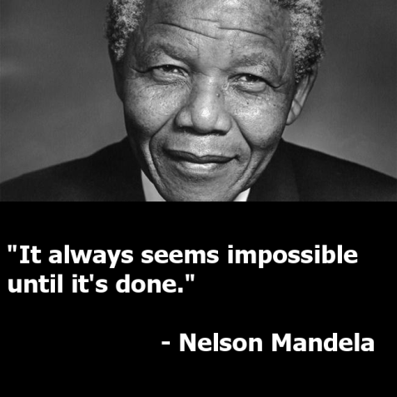
Leader Development
Changing “Positive Illusions”
(The elephant, rider, & path)
Motivating through “The Golden Circle”
Why
How
What
Cultivate your leadership abilities consistently and constantly!
(Long Walk to Freedom)
Notes:
Instructor Guidance:
Purpose: To identify and explain actions team leaders take for self improvement.
Discussion: The three main actions are based on the readings and other information pulled from knowledge and experiences of the developers of this course.
In their book “Switch” (Heath & Heath, pp.- 118-121) Positive Illusions refers to the exaggeration humans do when assessing one’s real skill and ability levels. Goes back to Lead Self where we discussed “We judge others by their actions and ourselves by our intent.” We believe we can assess our worth better than anyone else evaluating us. Attila the Hun accountant and non=profits trying to make a buck—processing claims for payments.
(Sinek) stresses that the Golden Circle (Chapter 3) explains how we determine our destiny. We first need to comprehend and head for our “why” we are doing an act before we can fully articulate how we are going to do what.
Nelson Mandela is one of the real “doers” in our international society. He was a significant leader who overcame prejudice and imprisonment to lead South Africa to a new beginning. He did this through love and mercy.
Questions: Engage the students to respond to each bullet and offer their opinions and suggestions that expand our understanding of the bullets.
Next Slide: Actions of Leader Development.

Slide 16
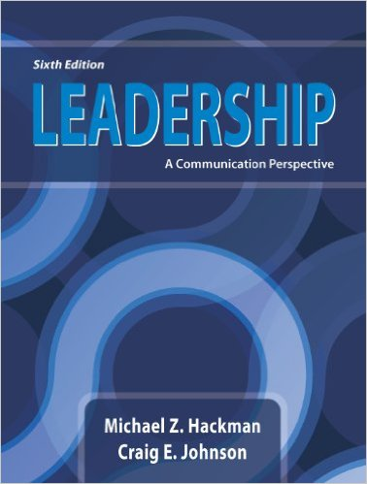
Actions of Leader Development
A lifelong Journey:
Proactive approach (Just Do It!)
Seek out training opportunities
Establish developmental relationships
Capitalize on experiences—yours and others
Develop and Stay active in your IDP
(2013, pp-373-390)
Notes:
Instructor Guidance:
Purpose: To identify and explain actions team leaders take for self improvement.
Discussion: The actions are based on the readings and other information pulled from knowledge and experiences of the developers of this course. Specifically Hackman and Johnson (2013, pp. 373-390) address the first four bullets.
Questions: Engage the students to respond to each bullet and offer their opinions and suggestions that expand our understanding of the bullets.
Next Slide: Team Activity.

Slide 17
Team Activity
Based on the “What leadership qualities do you think an effective team leader within your work environment should possess?” (an earlier team activity);
Establish a plan to build you as an effective team leader.
What developmental activities could be used?
What time sequence to achieve them?
How to track completion?
How to measure achievement?
One member of the team share with the seminar.
Notes:
Instructor Guidance:
Purpose: To have each team build an action plan on developing or improving their team leadership competence.
Discussion:
The activity is based on a previous activity, “What leadership qualities do you think an effective team leader within your work environment should possess?”
Key to this activity is for them to build their plan based on the qualities of the previous activity.
Their own ideas applied in a creative way that expands the entire seminar’s understanding and appreciation of a plan of action.
Questions: N/A
Next Slide: Summary.

Slide 18
Summary
Better understanding and appreciation of what is a Team Leader and what important purpose do they serve in any organization
Defined and described Team Leader qualities that positively influence the effectiveness of an organization
Building an action plan to develop us as effective and successful Team Leaders
The Gap Theory
pp. 84-85
Notes:
Instructor Guidance:
Purpose: Provide a review and summary of what was addressed in Session Three.
Discussion:
Address each bullet and encourage students to add emphasis to each one if they desire to do that.
The Gap theory (Heath and Heath pp. 84-85) is concerned with our curiosity and the need to answer questions that we get hooked on by either media or interactions with others. We are curious when we do not know the meaning of something. If we think we know it, we become less curious, and the danger then is we become over-confident.
Questions: N/A
Next Slide: N/A

